Slide 1

Efficient processing of ATLAS events analysis in platforms with accelerator devices
University of Minho
Department of Informatics
André Pereira
Prof. Alberto Proença (Advisor)
Prof. António Onofre (Co-Advisor)
Notes:
Bom dia, vou falar do processamento eficiente de análise de eventos do projecto ATLAS em plataformas com aceleradores

Slide 2
Index
Motivation
The ttH_dilep Analysis Application
State of the Art
Heterogeneous Platforms
Development Frameworks
Proposed Work

Slide 3
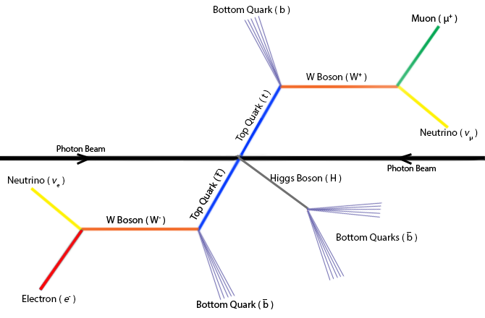
Motivation
The target model for an event
Reconstruction of the Top Quarks (t&t) system with Higgs boson
The analysis and reconstruction code => ttH_dilep
Goal: to develop efficient ttH_dilep code
Notes:
Representação esquemática actualmente aceite do sistema ttbar e do decaímento do bosão de Higgs resultante do evento
Objectivo: reconstruir os t t e os bosoes de Higgs utiliando código eficiente
Desafios:
- As características das partículas finais são gravadas pelo detector. Estes detectores tem uma resoluçao experimental que introduz um erro de 2% aos dados medidos
- Neutrinos não são detectados mas podem ser reconstruídos por um processo denominado de reconstrução cinemática
- Software de análise perceber quais jactos pertencem ao ttbar ou à reconstrução de Higgs

Slide 4
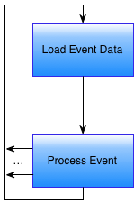
Structure of ttH_dilep
For each event in the input file

Slide 5
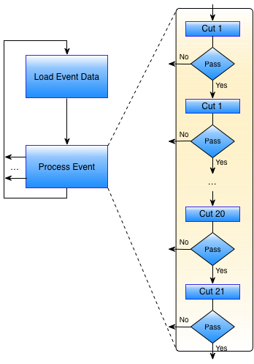
Structure of ttH_dilep
All cuts except 20
Simple filters

Slide 6
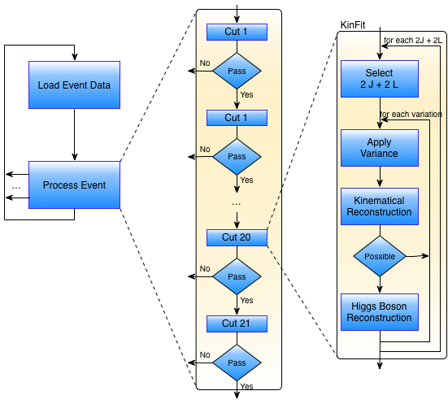
Structure of ttH_dilep
Cut 20
Complex filter: KinFit

Slide 7
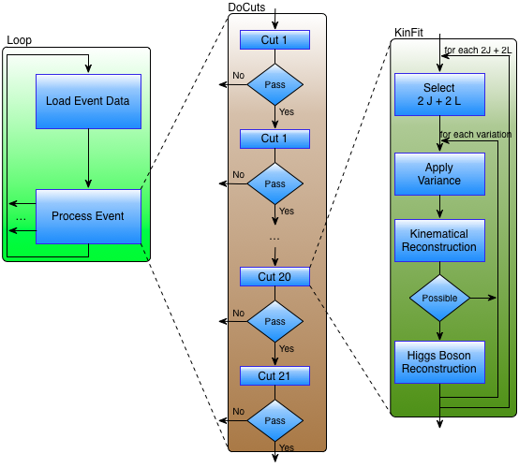
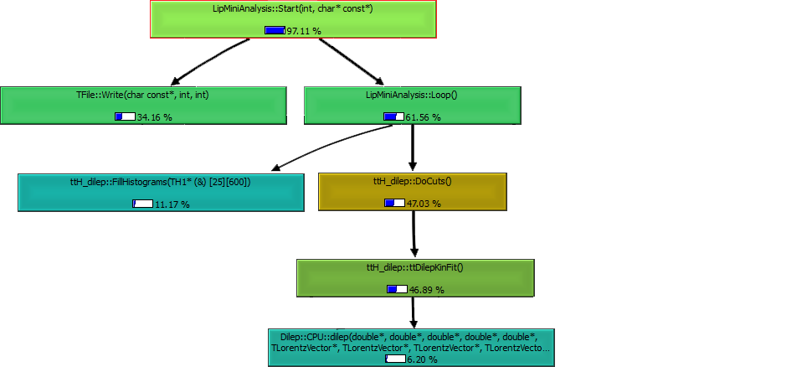
Structure of ttH_dilep
Callgraph of the original ttH_dilep with no variations

Slide 8
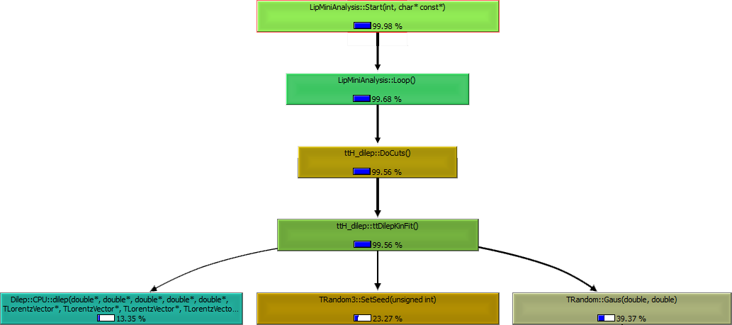
Structure of ttH_dilep
Callgraph of the original ttH_dilep for 256 variations per combination

Slide 9
Critical regions in ttH_dilep
# variations per event

Slide 10
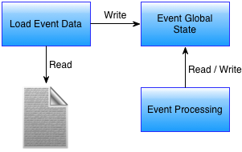
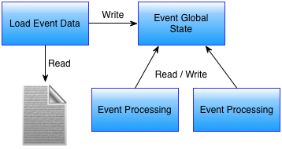
Improving efficiency with parallelism…
Sequential
Parallel

Slide 11
… no way with event global state!
Sequential
Parallel

Slide 12
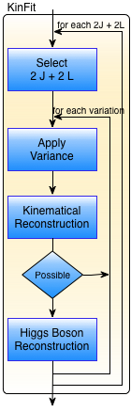
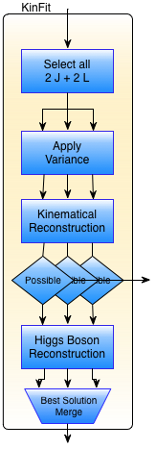
Alternative 1a: parallelize KinFit, shared memory, no h/w accelerators
Sequential
Parallel
Notes:
“Independent” of global state
Has 2 nested cycles
Outer cycle (# comb) is event dependent
Inner cycle (#var) is user defined

Slide 13
Some results (mudar título)
# of variations per event

Slide 14
Some results (mudar título)

Slide 15
Some results

Slide 16
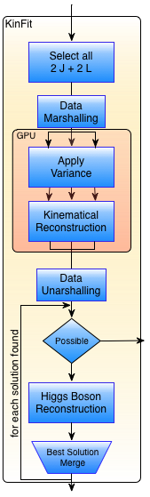
Alternative 1b: parallelize KinFit, shared memory, with GPU accelerator
Parallel, no accelerator
Parallel with GPU
Notes:
“Independent” of global state
Has 2 nested cycles
Outer cycle (# comb) is event dependent
Inner cycle (#var) is user defined

Slide 17
Some results

Slide 18
The problem…
Optimal layout
Current layout

Slide 19

Alternative 1c: parallelize KinFit, shared memory, with MIC accelerator
Native, similar to Shared Mem
Offload, similar to GPU
Notes:
“Independent” of global state
Has 2 nested cycles
Outer cycle (# comb) is event dependent
Inner cycle (#var) is user defined

Slide 20
Alternative 1c: parallelize KinFit, shared memory, with MIC accelerator
Native, similar to Shared Mem
Offload, similar to GPU
Notes:
“Independent” of global state
Has 2 nested cycles
Outer cycle (# comb) is event dependent
Inner cycle (#var) is user defined

Slide 21
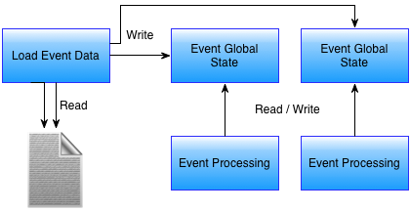
Alternative 2: a global state per event
Sequential
Parallel

Slide 22
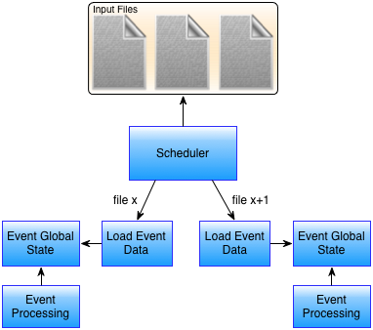
Alternative 3: events from different files
Sequential
Parallel

Slide 23
Some results

Slide 24
Some results

Slide 25
Efficient processing of ATLAS events analysis in platforms with accelerator devices
University of Minho
Department of Informatics
André Pereira
Prof. Alberto Proença (Advisor)
Prof. António Onofre (Co-Advisor)

